Slide 1

Interactive Visualization Project NYPD Shooting Incident Data
DREAM TEAM 2 – May 1st, 2021

Slide 2

Index
Project Overview
Dataset
JavaScript Code & Visuals
Heatmap
Plotly
HTML/CSS

Slide 3

Project overview
We chose to build a dashboard with multiple charts that update from the same data source
A New York City Police Department (NYPD) dataset listing all shooting incidents in the city was used for all visuals presented
A custom landing page was built with HTML and CSS to visualize the results

Slide 4

Dataset
~22,000 shooting incidents
Demographics for each perpetrator
Data refreshed from quarterly manual extract by NYPD
Offered in json
14 years of data
Coordinates for each incident recorded
All five boroughs included

Slide 5
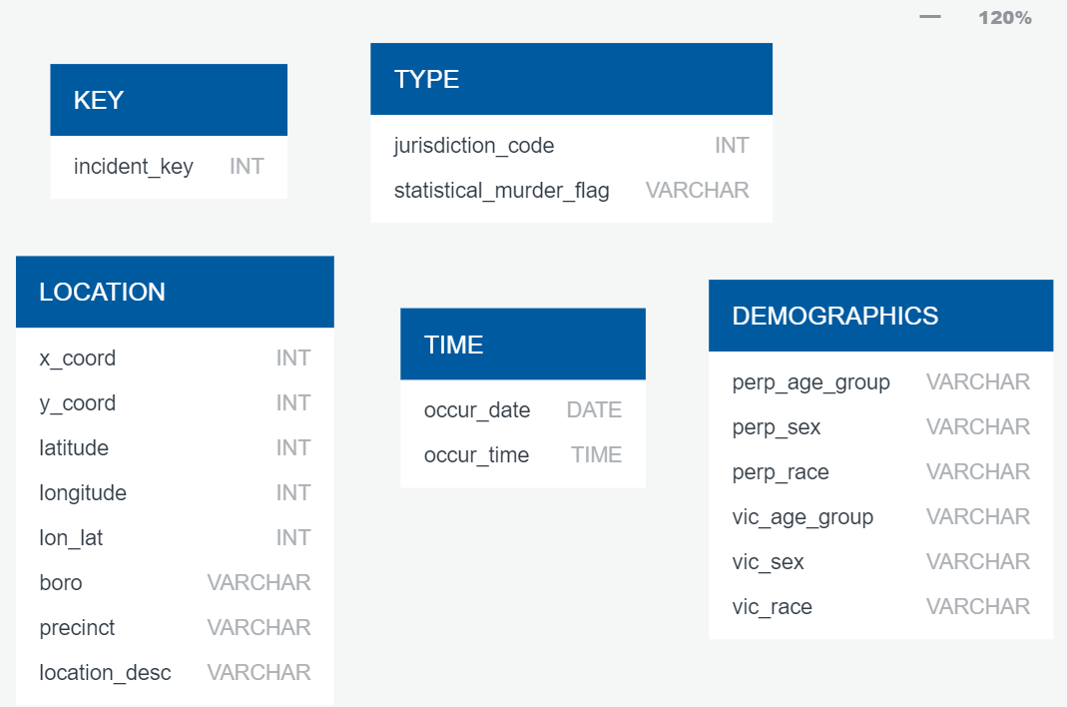
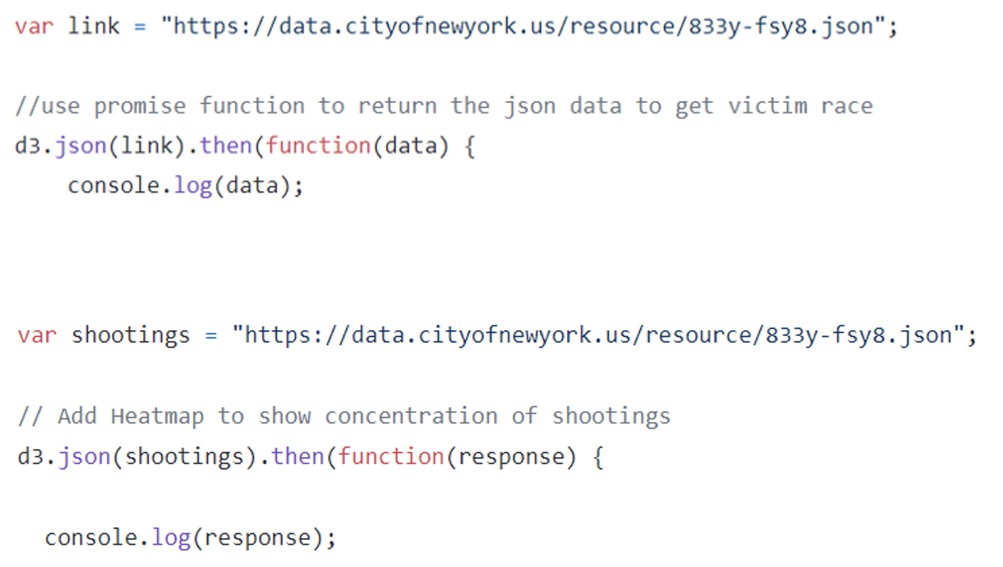
Dataset Attributes

Slide 6
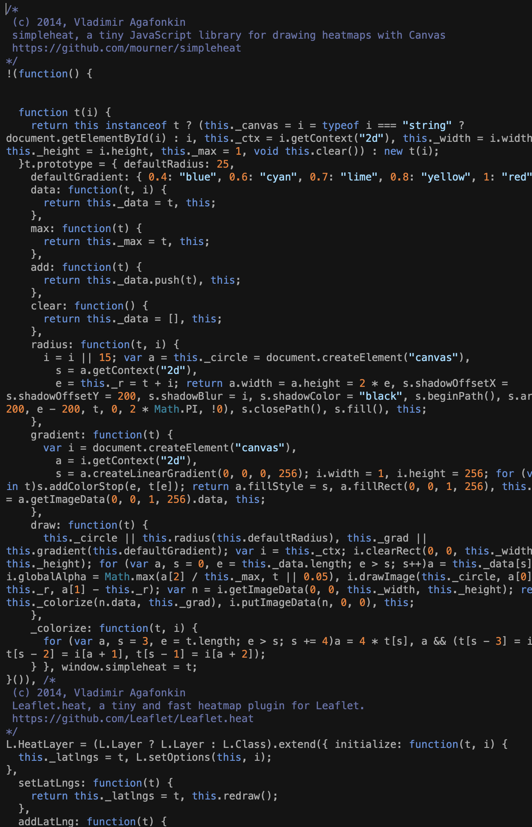
Leaflet Map with Markers and Heatmap
Base map with layers as overlays for the following:
outline of boroughs
nyc.geojson dataset
markers for each shooting incident color-coded per borough
heatmap
Markers
used the Extra-Markers plugin and d3 to assign marker color based on borough
popup contains a scrollable list of info about each incident
Heatmap
used leaflet-heat plugin

Slide 7
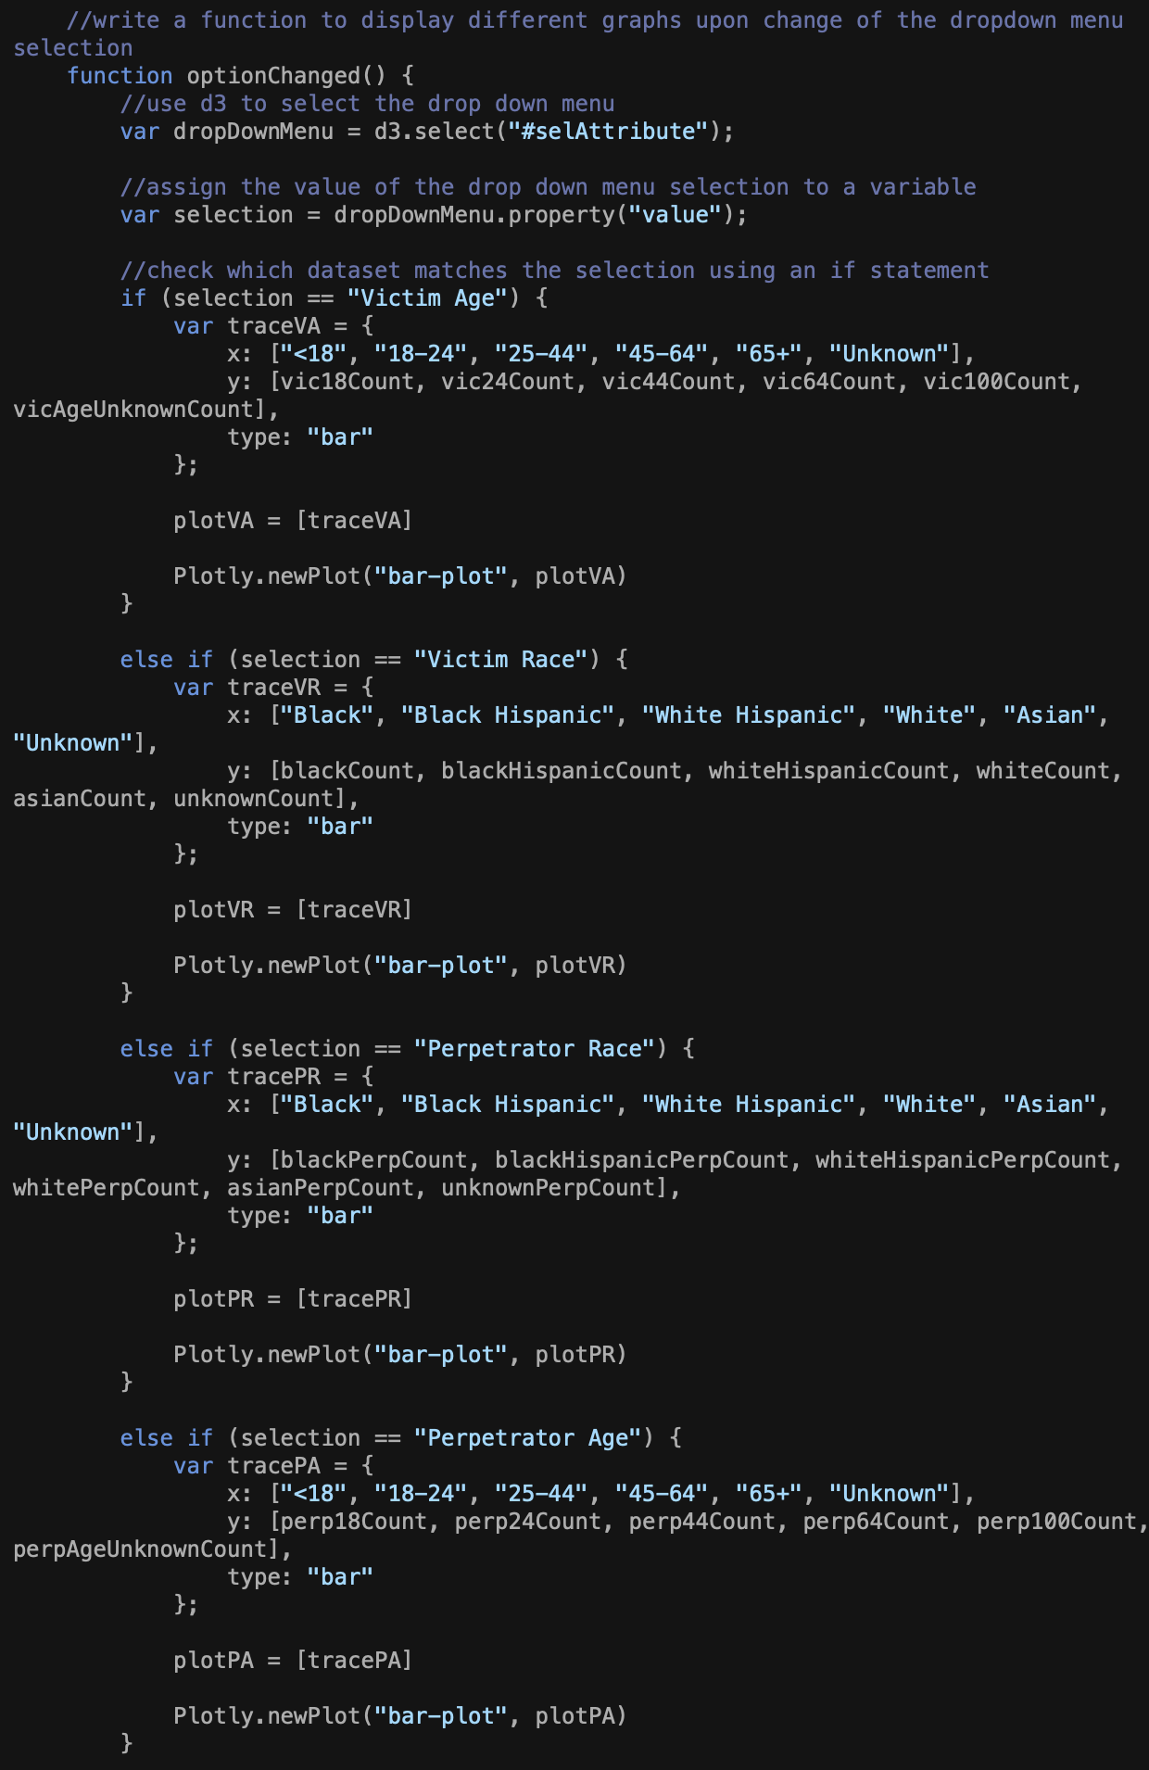
Plotly
Used d3 promise to call upon and parse json data
Ran "forEach" function and pulled variables of interest from each object (corresponding to 1 shooting incident) and pushed to separate arrays
Used ".length" function on each array to accumulate counts of each attribute for all shooting incidents
Utilized Plotly to plot each attribute and its frequency
Triggered change events upon drop-down selection

Slide 8
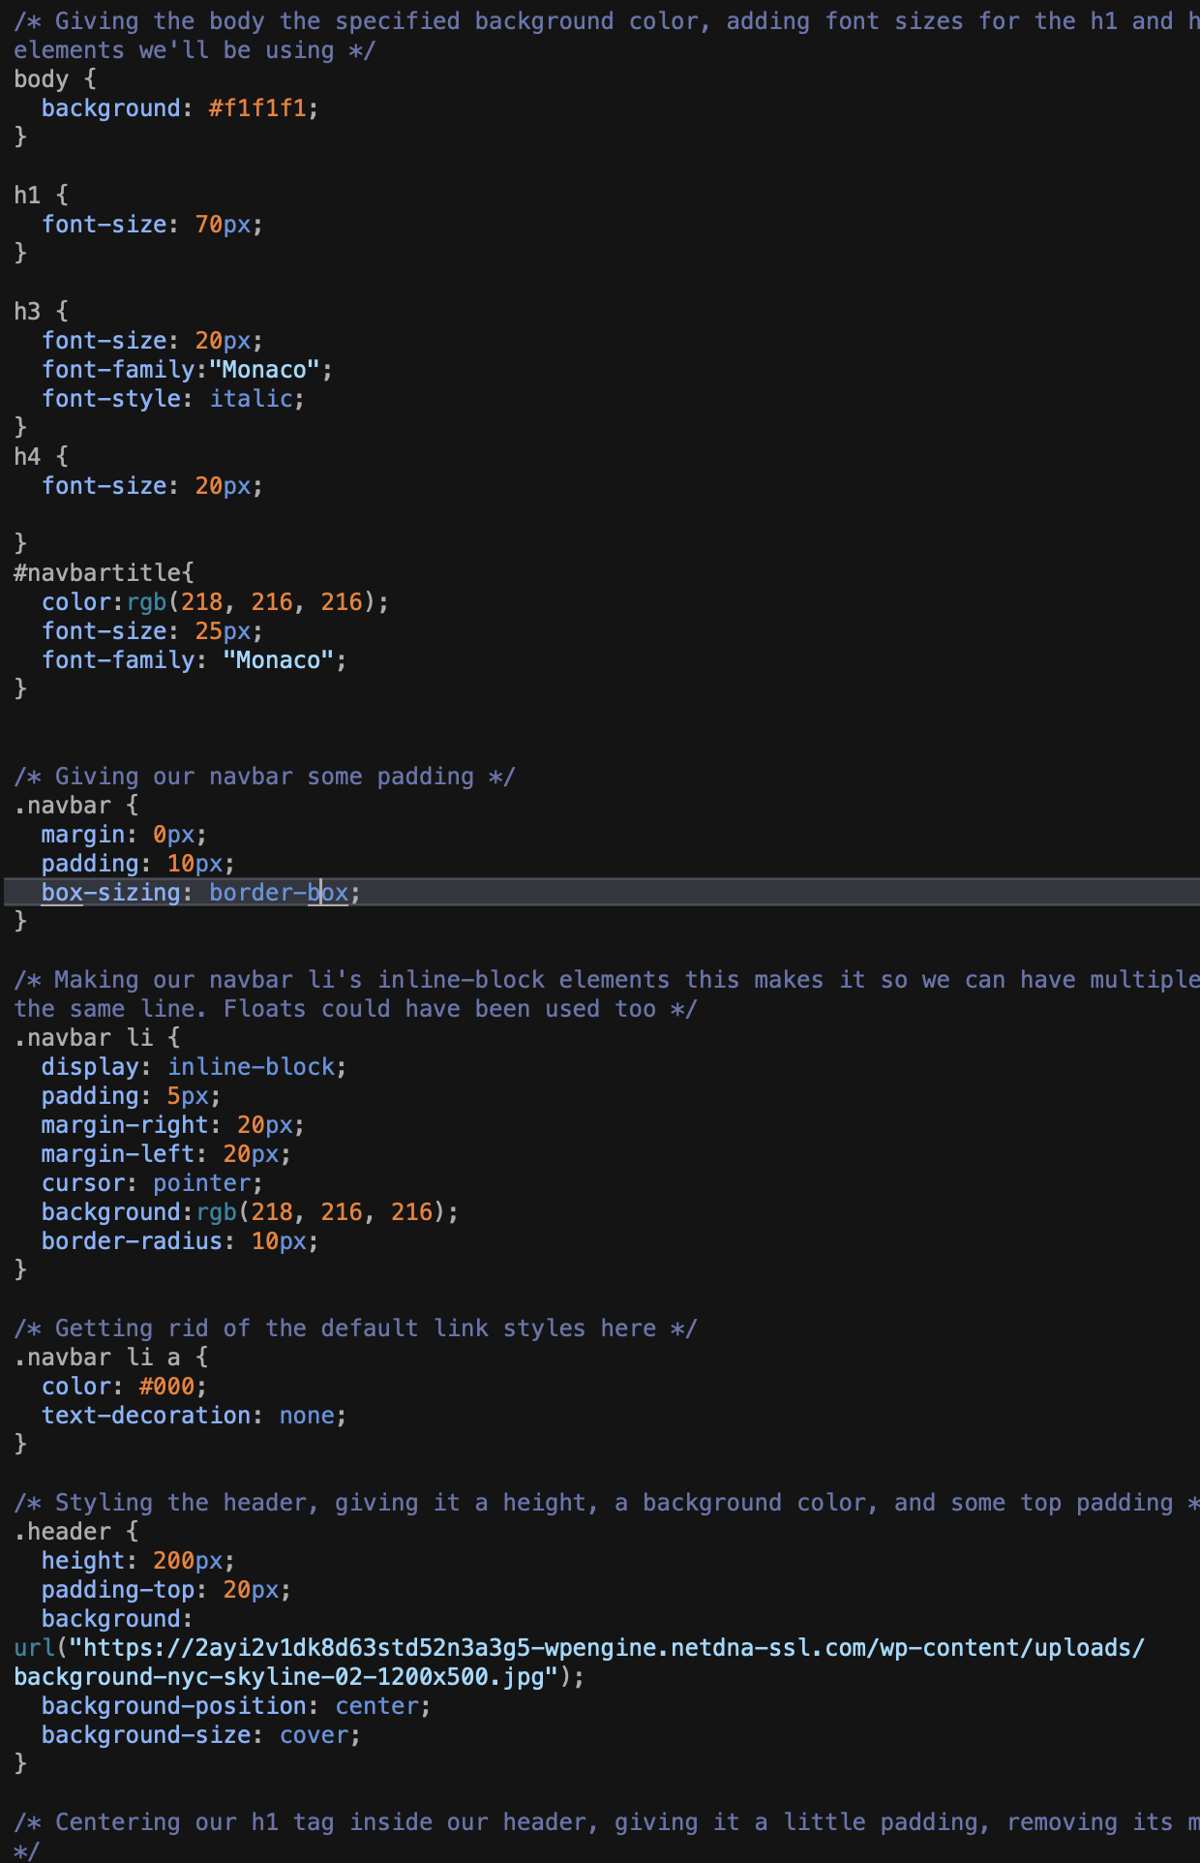
HTML/CSS
Bootstrap
Navigation bar that jumps you to the part of the page that youw ant when you click on the tab
fontawesome
Library that allowed ability to add logos into the navigation bar
CSS
Created fonts, size and colors for different headers and text throughout the site
Formatted the size of charts

Slide 9
Thank you!
Colin O’Neill
Emma Kruis
Gabriel Bang
Konsta Jokipii
Mary Colasanto

